Slide 1
Lecture 11 Social Media & its Impacts on Society

Slide 2
Social Media Circles
Some of the renowned ones are:
LinkedIn
Blogs/Discussion forums
YouTube
Lesser Extent: Twitter and Facebook
However, Facebook has just launched Branch Out
Professional networking using FB’s reach

Slide 3

LinkedIn
Build your network:
Stay in touch with current and former peers
Create community, expand contact lists and introduce connections
Showcasing skill set:
publishing your resume or establishing expertise for potential clients or employers to view
Work your network, make yourself visible:
Join groups, gather relevant information, participate in discussions, receive industry updates as they occur
Find targeted people with a specific skill sets:
for hiring or informational/networking purposes

Slide 4
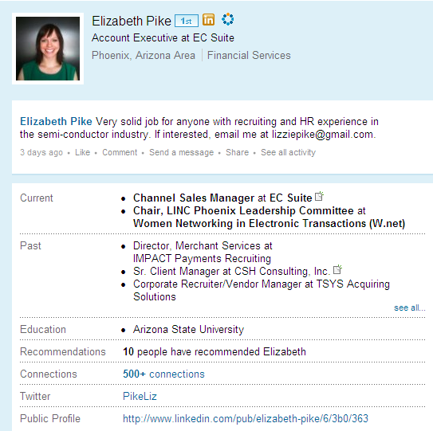


Slide 5
LinkedIn
JOB SEARCH: Utilized to find jobs, people and business opportunities recommended by someone in one's contact network – levels 1,2,3
TALENT SEARCH: Employers can list jobs and search for potential candidates
NETWORKING RESOUCE: Members can review circle profiles of to determine which of their existing contacts can introduce them to people they want to know
PERSONAL-PROFESSIONAL BRANDING: Users can post their own photos and view photos of others to aid in identification
INDUSTRY UPDATE RESOURCE: Register to follow companies to get notifications and relevant information
INFORMATION PORTAL: Users can bookmark (profiles, jobs, etc.) to return to for future reference

Slide 6
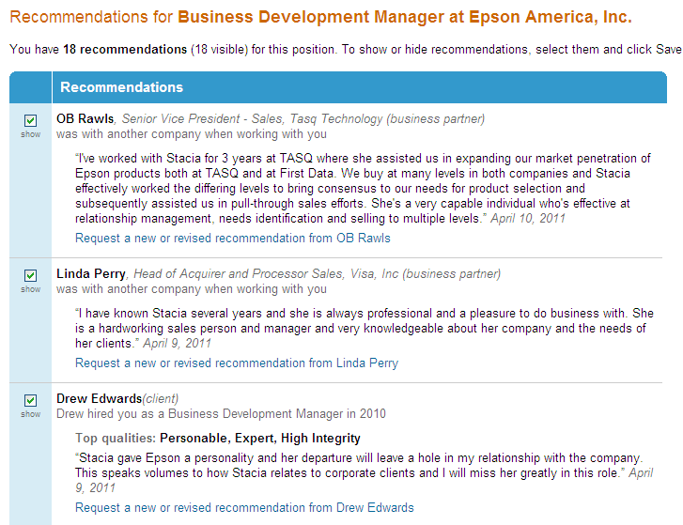

Slide 7
Maximizing LinkedIn
Strive for 100% completeness on profile and keep updated (new skill sets, new company)
Continue to reach out, make connections, or reply to conversations –this pops up on your connection’s activity feed
Post events or new products/information
Follow companies, join and create group
Helpful for industry info, adding contacts to network and all groups have a job posting capability

Slide 8
Marketing your Profile
Include a LinkedIn link on your signature
Ask for recommendations after completing business
Integrate business tweets
Optimize your profile
Focus on developing a quality network

Slide 9


Blogs and Discussion Forums
Receive real time industry updates
Search for new product releases
Expand marketing tools for customer base
Reach new clients
Follow and engage in industry discussions
Serves as a ‘classifieds’ page or open source link

Slide 10

You Tube
Showcase products:
Compare speed between dial up and wireless terminals
Launch new marketing campaigns for companies, act as a commercial for company
Demos for new products/services
Build personal-professional brand

Slide 11

Twitter
Micro blogging site
Sharing of industry information/updates, usually through sharing links
Can be useful in following new companies and their technology
Receive up to date info through following active users
Conversation starter
Forum to create company buzz
External campaigns or contests

Slide 12

Facebook
Becoming an important marketing strategy to increase brand awareness and customer loyalty
i.e. “LIKE” button
Facebook has wider reach but more casual than LinkedIn
Mixed audiences can become tricky
Introducing Branch Out

Slide 13

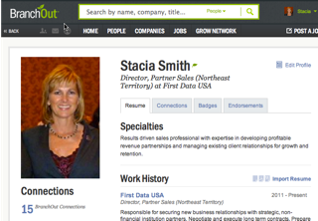
http://branchout.com/about/productTour

